Slide 1
Causality of Superhost Status
MGMT 683 Innovation & Management
Team 9 :
Harish Datta Chitneni
Goutham Kumar Vemasani
Chaitanya Krishna Burri
Sai Bheeshma Ramaraju Pagilla
Xiaoyu Guan

Slide 2
Problem Statement

Slide 3

Superhost Criteria
80%
Proportion of 5 star review
90%
Host Response rate
0
Cancellations
10
Number of trips hosted

Slide 4
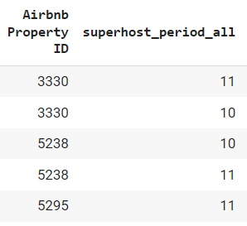
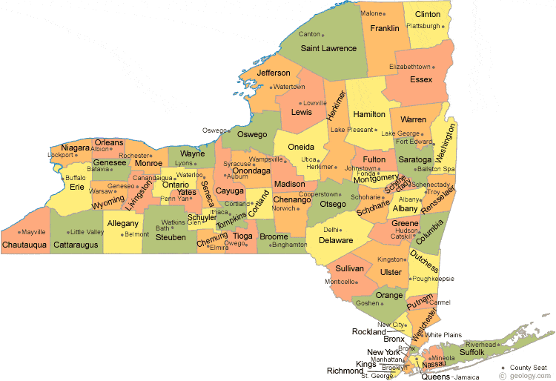
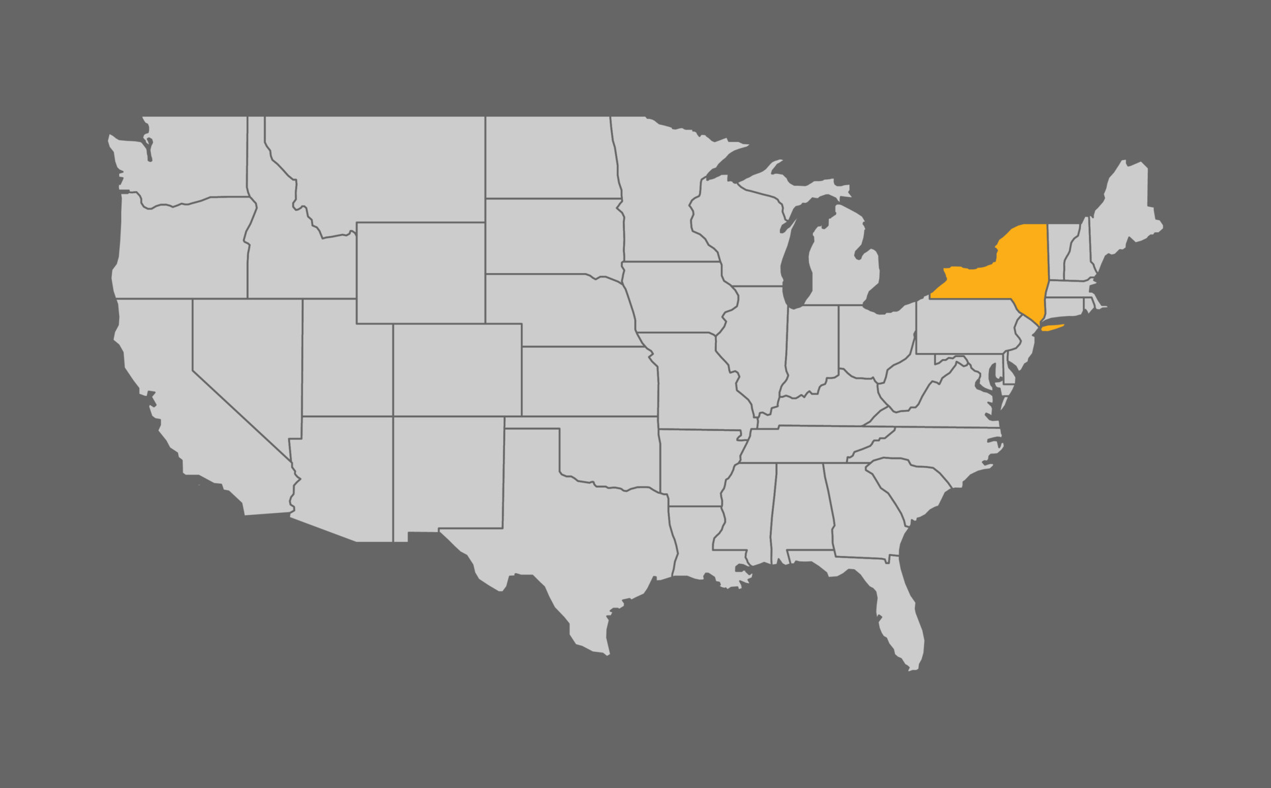
New York Dataset
superhost_observed_in_period (t) = 10, 11
Shape: 64,106

Slide 5





Problem Statement
Superhost
Let’s go to superhost!
Does a Superhost status effect the occupancy rate?

Slide 6
Approach & Analysis

Slide 7
Confined Sample Space
Cut off
Missed
Pass
Just Miss
Just Pass

Slide 8
Data Filtering
All the 10th period records for just_Missing the superhost_status
Cut off
Property ID | Period_10 | Superhost_status
3330 | 10 | Just_Miss
5238 | 10 | Just_Miss
5295 | 10 | Just_Miss
5945 | 10 | Just_Miss
7816 | 10 | Just_Miss
t -1 (10th period)
Just Miss
Records: 5,843
Property ID | Period_11 | Superhost_status
3330 | 11 | Just_Miss
5238 | 11 | Just_Miss
5295 | 11 | Just_Miss
5945 | 11 | Just_Pass
7816 | 11 | Just_Pass
t (11th Period)
Just Miss
Just Pass
Records: 3,633

Slide 9
Thresholds for Just Miss & Just Pass Group
For Just Miss
For Just Pass
70%
80%
80%
90%
Proportion of 5-star review
80%
90%
90%
95%
Host Response rate
0
5
0
Cancellations
8
10
10
12
Number of trips hosted

Slide 10
Summarize Data Cleaning
New York Dataset Records: 437, 583
Property ID | Period | Superhost | JM/JP
15257024 | 11 | 1 | Just Pass
15324045 | 11 | 1 | Just Pass
15411327 | 11 | 1 | Just Pass
3330 | 10 | 0 | Just Miss
5238 | 10 | 0 | Just Miss
3330 | 11 | 0 | Just Miss
5238 | 11 | 0 | Just Miss
5295 | 11 | 0 | Just Miss
8024 | 11 | 0 | Just Miss
8025 | 11 | 0 | Just Miss
Filter out only the records in the evaluation period 10, 11
df (period = 10, 11)
Records : 64,106
Filter out only the just Miss records in the evaluation period 10
df (period = 10)
Records : 5,843
For the same Airbnb Properties in the above step, filter out just Miss and just Pass records for the evaluation period 11
Defining treatment/control groups:
Properties:
Just Pass: Treatment Group
Just Miss: Control Group
df (period = 11)
Records : 3,633

Slide 11
Treatment vs Control
Time Period: 10
Time Period: 11
Time
Control
Treatment
Control
Treatment
Superhost
Control Group: Properties that just Miss superhost status in period 11
Treatment Group: Properties that just Pass superhost status in period 11

Slide 12
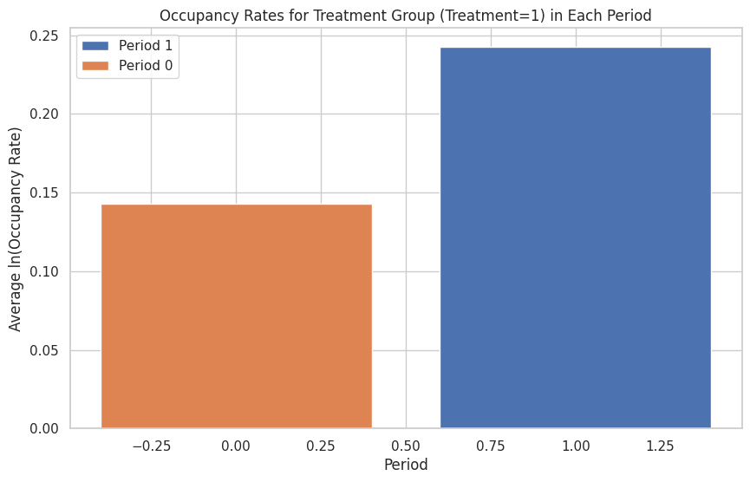
Change in Occupancy rates
Increase in Average ln(Occupancy rate) from Period 10 to Period 11
But how much of this increase is caused by just the superhost badge?

Slide 13


Defining Superhost effect
$$Difference in Differences \left(DiD\right):$$
Occupancy Rate
Occupancy Rate in Control Group after treatment
Occupancy Rate in Treatment group after treatment
--
Superhost Effect
Just Pass
--
Just Miss vs Just Pass
Occupancy Rate in Control Group before treatment
Occupancy Rate in Treatment group before treatment
Just Miss
Effect of time
--
${{DiD= Y}_{it1}−Y_{it2}= }_{ }$ $β3$
After=0
After=1

Slide 14
The Equation
Treatment + After + After*Treatment
Occupancy Rate
=
=
Just Pass + Period + Period*Just Pass
DiD term
${Y_{it}={{{β0+ β1X}_{just pass, t }+β2X}_{period, t }+β3X}_{just pass, t }X}_{period }$+ $β_{i=4,5..n}X_{i=4,5..n, t−1 }$
Note: For few variables we have considered data for t-1 periods.

Slide 15



Feature Selection: Y in time-period ‘t’
$$Xi in time period t−1$$
$$Xi$$
Variables influencing superhost status:
prop_5_StarReviews_pastYear
numReserv_pastYear
hostResponseAverage_pastYear
numCancel_pastYear'
Property features in customer’s visibility:
'Pets Allowed',
'Property Type’,
'Listing Type’,
'Bedrooms', 'Bathrooms’
'Max Guests’,
'Cleaning Fee (USD)’
'Minimum Stay’,
'Number of Photos’,
'Instantbook Enabled’,
'Nightly Rate’,
'Number of Reviews’,
'Rating Overall'

Slide 16
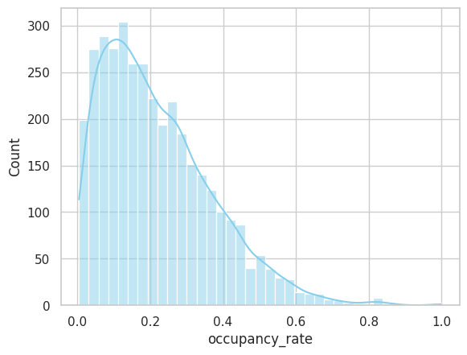
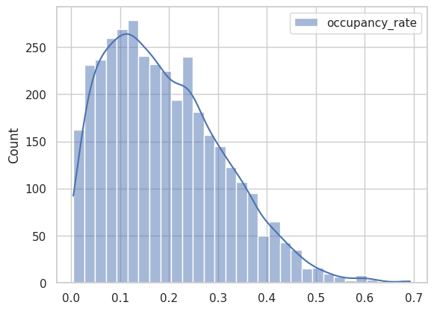
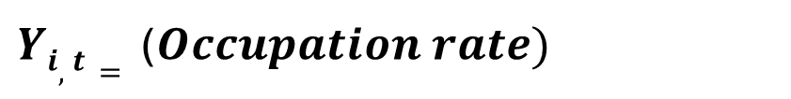
Target Variable
$Yi,t=$ ($Occupation rate)$
Log Transform
SKEWED

Slide 17
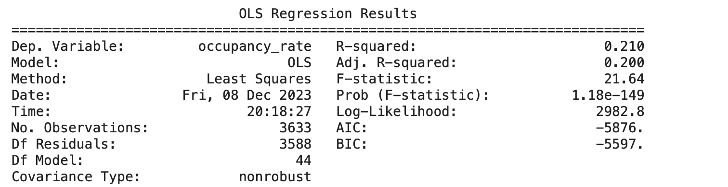
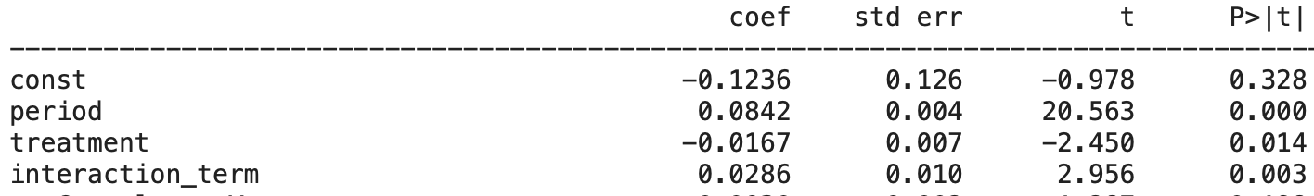

Results
We have built a linear regression model with ln (occupancy_rate) as the dependent variable and the selected feature variables as independent variables.
$$R^{2} =0.21$$
Significant p value for interaction term

Slide 18
Key Takeaways

Slide 19
Inference 1: Effect of Superhost
ln(occupancy_rate) = -0.1236 + 0.0842 * period – 0.0167 * treatment+ 0.0286 * period * treatment + ………….
Being a Superhost
From the equation, we can infer the following:
+2.9%
in occupancy rate
On average, being a superhost will cause an increase of 2.90% in occupancy rate

Slide 20
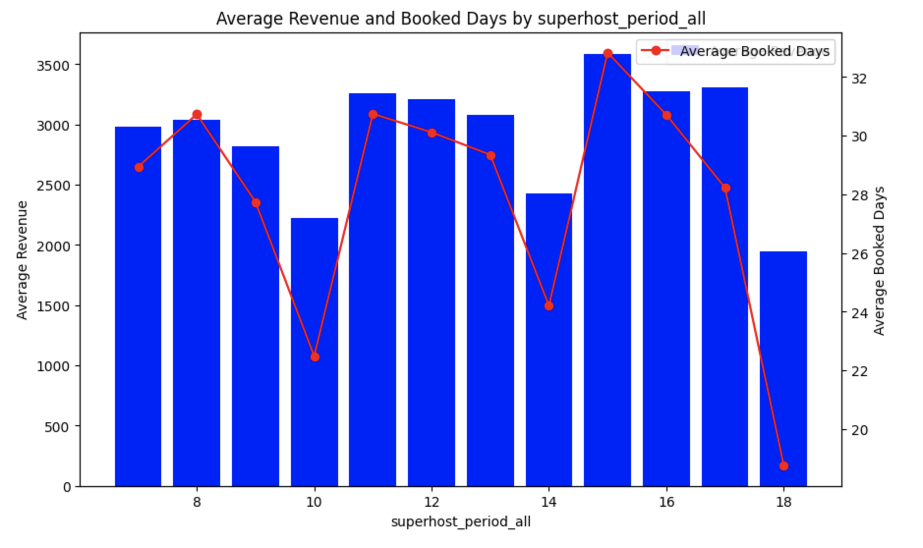
Inference 2: Effect of period
On average, the occupancy rate has increased by 8.78% as we move period 10 (Jan-Mar) to period 11 (Apr-Jun)
From the data, we can infer that on average, the occupancy rates in New York city have witnessed a significant jump in bookings as we move into the Spring (April to June) from winter.
t₁₀
t₁₁
Source: http://hotelinvestmentstrategies.com/seasonality-trends-in-the-u-s-lodging-industry-1987-2018/

Slide 21




Recommendations
For Hosts
Instant book option enabled has increased the occupancy rate by 2.11%. This increases the convenience to book for the users.
Number of reviews has a positive effect on occupancy rate. For every 1 additional review, there will be a 0.5% increase in occupancy rate.
For Airbnb
communicate the benefits of achieving Superhost status to hosts, emphasizing the positive impact on occupancy rates and overall hosting success.
Develop enhanced analytics tools for hosts to track their performance metrics, understand how they compare to Superhost criteria, and identify areas for improvement.

Slide 22
Limitations & Future Scope
For the purpose of our analysis, we have assumed that the effect of superhost badge will have an immediate effect on the occupancy rates in the current evaluation period. However, as the bookings can happen for around 60-day period, the tag effect could be partially delayed to the next evaluation period.
!
!
We have limited our analysis to the region of New York. The analysis could be extended to all regions to identify more accurate patterns.
!
For the purpose of interpretation, a linear regression model has been built on the available dataset. To increase the accuracy of predicting the occupancy rates, we can leverage more complex models.

Slide 23
Thank You!

